Slide 1
Tree Map
Kareti Pujitha

Slide 2
TreeMap:
Def: A TreeMap in Java is a collection that organizes its elements in a sorted order based on their keys. It's implemented as a Red-Black tree and allows for quick retrieval of elements based on their keys. Each element is stored as a key-value pair, and the keys are sorted in a natural order or using a custom comparator.
Syntax: TreeMap<Key, Value> numbers = new TreeMap<>();

Slide 3
Tree Map:
Imagine a TreeMap in Java like a dictionary where everything is kept in order. Each item (let's call them "entries") has two parts: a "key" and a "value." The key is like a word in a dictionary, and the value is its definition.
Now, this special dictionary automatically arranges its words (keys) in alphabetical order. So, when you want to look up a word (key), you can easily flip to the right spot because they're all nicely sorted. It's like having a super organized dictionary that helps you find things really quickly!

Slide 4
Advantages of TreeMap:
Ordered Structure: TreeMap maintains its elements in a sorted order based on their keys. This makes it easy to retrieve data in a sorted manner.
Efficient Operations: It provides efficient implementations of the Map interface, ensuring quick insertion, deletion, and retrieval of elements.
Use of Comparator: Allows you to specify a custom order for sorting elements using a Comparator. This flexibility in sorting can be very powerful.

Slide 5
Disadvantages of TreeMap:
Slow for inserting elements
Key restriction: The keys in a TreeMap must implement the java.lang.Comparable interface, or a custom Comparator must be provided. This can be a restriction if you need to use custom keys that do not implement this interface.

Slide 6
Features of a Tree Map
Ordered Storage: Tree Map maintains its elements in a sorted order based on their keys. This allows for easy retrieval of data in a sorted manner.
Key-Value Pairs: Each element in a Tree Map is a key-value pair, where elements are accessed, added, and deleted based on their keys.
Balanced Tree Implementation: Internally, it's implemented as a Red-Black tree, a self-balancing binary search tree. This ensures relatively stable and efficient time complexities for operations.
Custom Sorting: TreeMap allows the use of a Comparator or the natural ordering of elements for sorting

Slide 7
Methods:
Certainly! TreeMap in Java offers various methods to manipulate and retrieve its key-value pairs. Here are some of the essential methods:
Insertion and Modification:
put(K key, V value): Adds a key-value pair to the TreeMap. If the key already exists, the value is updated.
putAll(): Adds all the key-value pairs from a specified map to the TreeMap.

Slide 8
Removal:
remove(Object key): Removes the key-value pair associated with the specified key.
clear(): Removes all the key-value pairs from the TreeMap.

Slide 9
Accessing Elements:
get(Object key): Retrieves the value associated with the specified key.
firstKey(): Returns the first (lowest) key in the TreeMap.
lastKey(): Returns the last (highest) key in the TreeMap.
ceilingKey(K key): Returns the least key greater than or equal to the given key.
higherKey(K key): Returns the least key strictly greater than the given key.
floorKey(K key): Returns the greatest key less than or equal to the given key.
lowerKey(K key): Returns the greatest key strictly less than the given

Slide 10
Information Retrieval:
size(): Returns the number of key-value pairs in the TreeMap.
isEmpty(): Checks if the TreeMap is empty.
containsKey(Object key): Checks if the TreeMap contains a specific key.
containsValue(Object value): Checks if the TreeMap contains a specific value.

Slide 11
Submap Operations:
subMap(K fromKey, boolean fromInclusive, K toKey, boolean toInclusive): Returns a view of the portion of the TreeMap whose keys range from fromKey to toKey.
headMap(K toKey, boolean inclusive): Returns a view of the portion of the TreeMap whose keys are strictly less than toKey.
tailMap(K fromKey, boolean inclusive): Returns a view of the portion of the TreeMap whose keys are greater than or equal to fromKey
These methods allow various operations on TreeMap, facilitating insertion, retrieval, removal, and creating submaps based on specified keys or ranges.

Slide 12
Creating a TreeMap
Syntax: TreeMap<Key, Value> students = new TreeMap<>();
In the above code, we have created a TreeMap named studentss without any arguments. In this case, the elements in TreeMap are sorted naturally (ascending order).
However, we can customize the sorting of elements by using the Comparator interface.
Here,
Key - a unique identifier used to associate each element (value) in a map
Value - elements associated by keys in a map

Slide 13
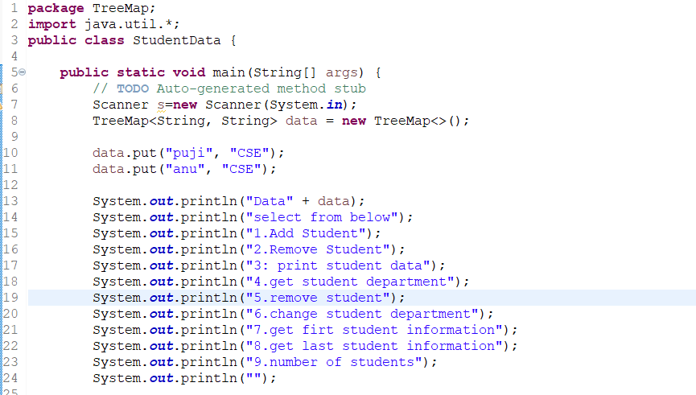
Example student data:
Parameters:
This code creates a Tree Map that stores student names as keys and their respective departments as values. It demonstrates adding students, retrieving a specific student's department, finding the first and last students in the TreeMap, checking if a student is present, removing a student, and determining the number of students in the TreeMap.
Key - Student Name(String)
Value - Department Name(String)
Operations:

Slide 14
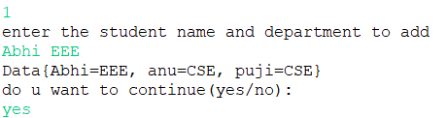
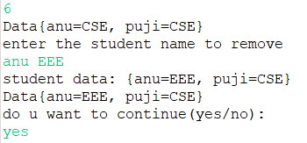
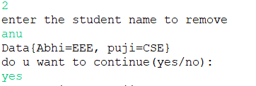
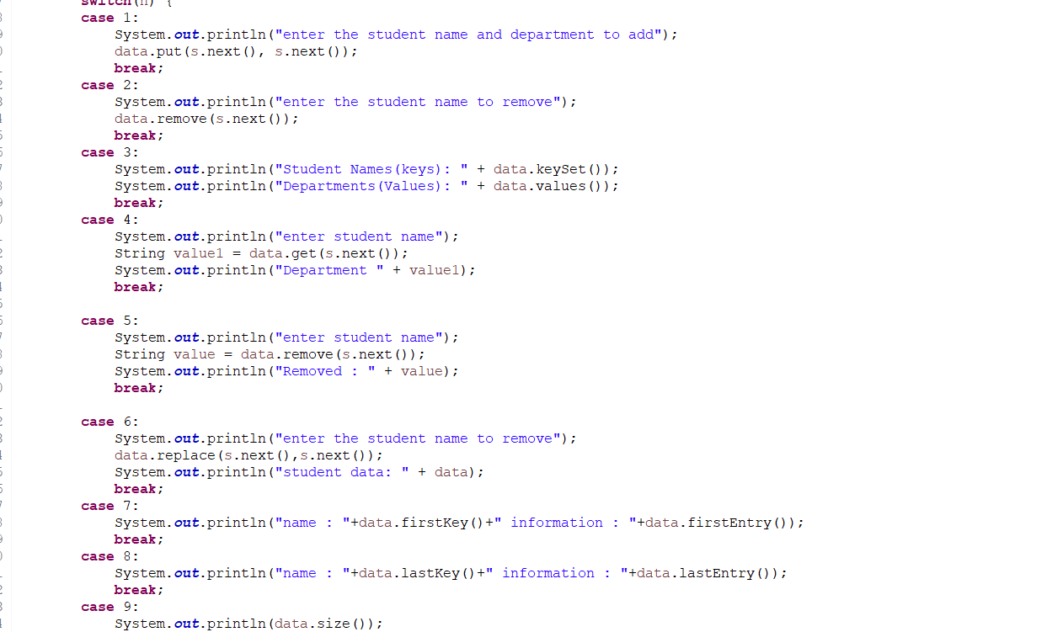
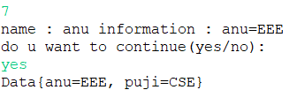
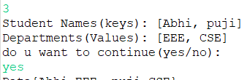

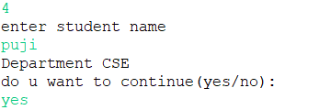
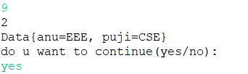

Slide 15
Thank you!

